Slide 1
Finding Family in Norway: What you should Know Before you Travel
Fredrik Larsen Lund, adviser
National Archives of Norway (Riksarkivet)

Slide 2
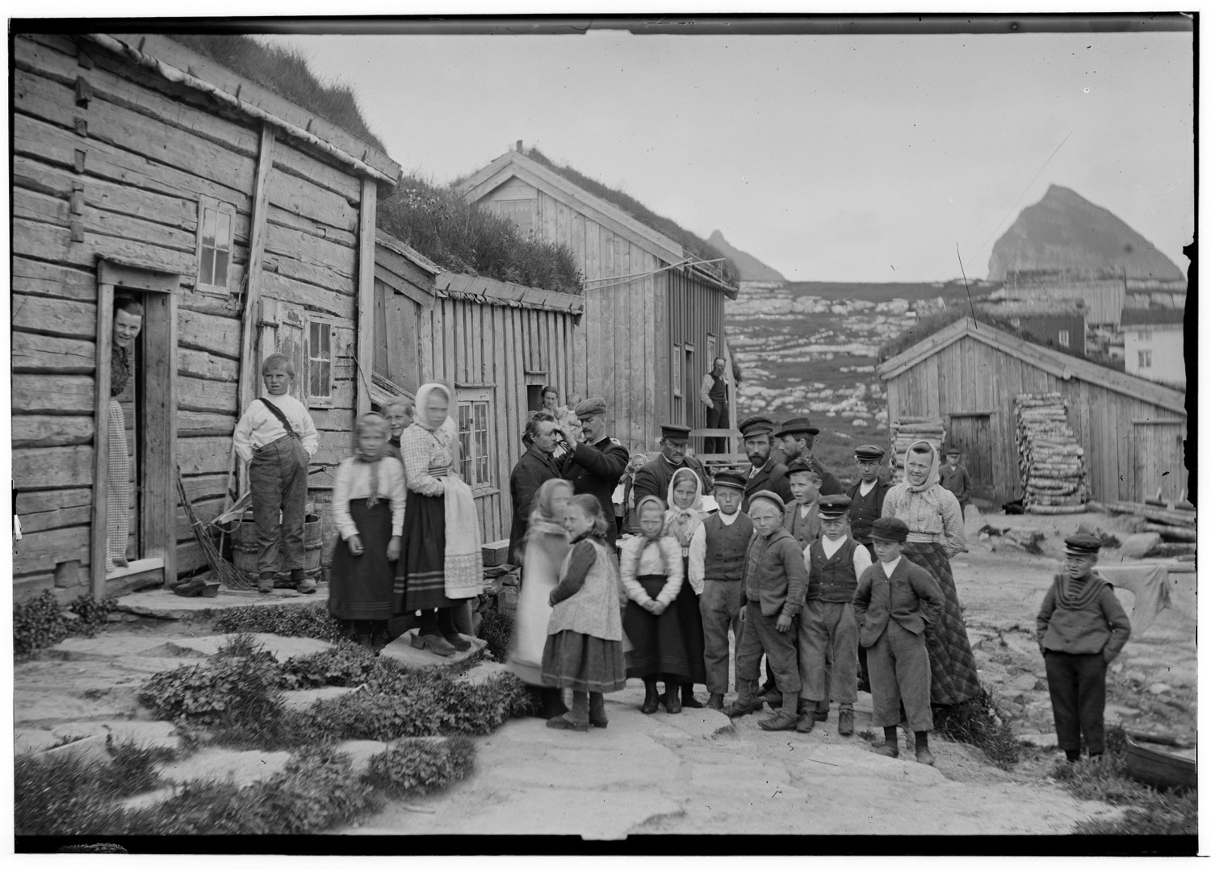

Slide 3
Before you go

Slide 4
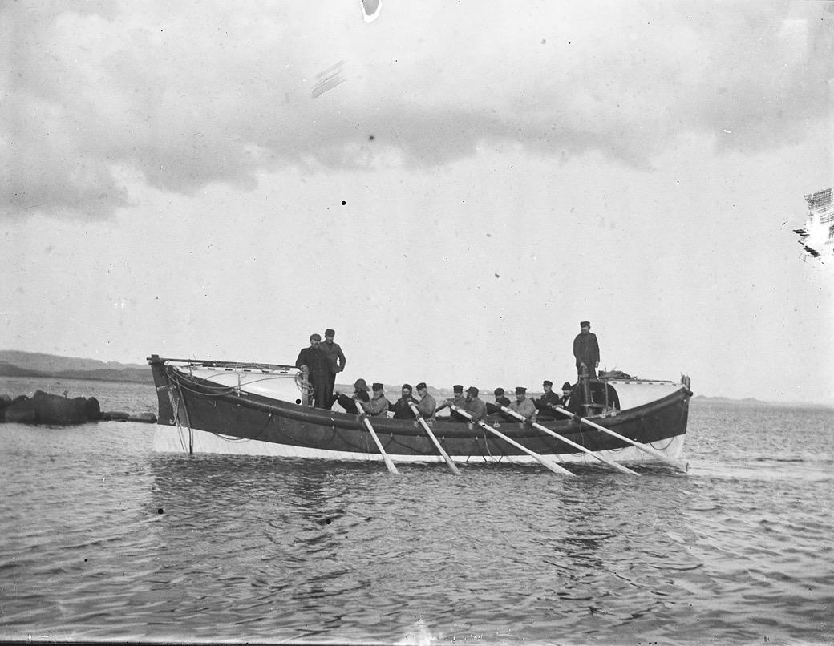
Find out about your family

Slide 5
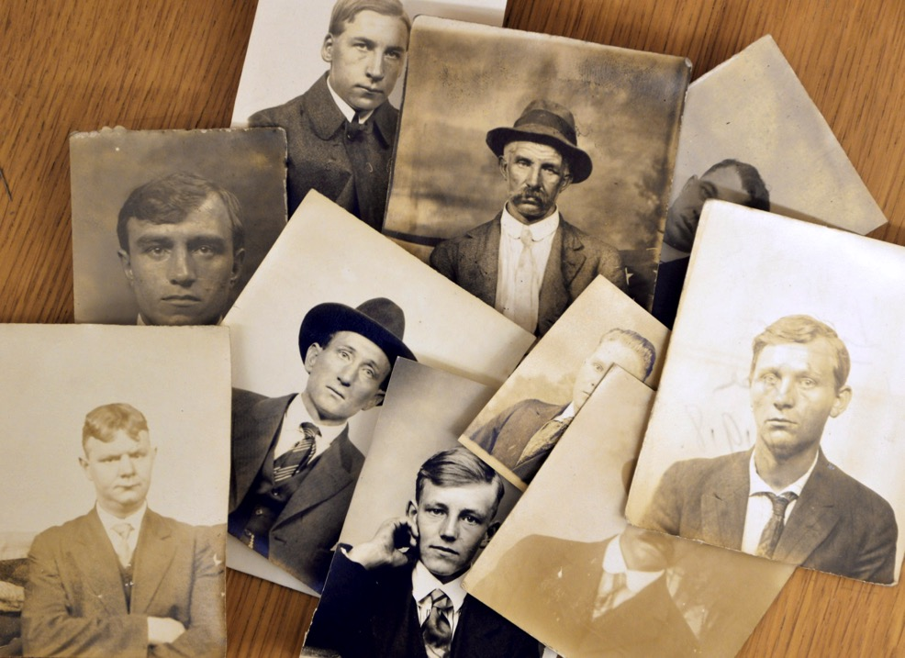
Collect and copy stuff
?

Slide 6
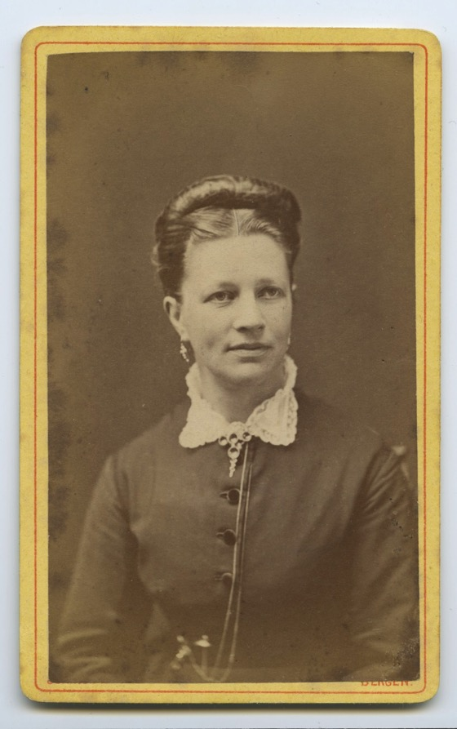
Learn some Norwegian
Hei, jeg heter Anne?
Hva heter du?

Slide 7
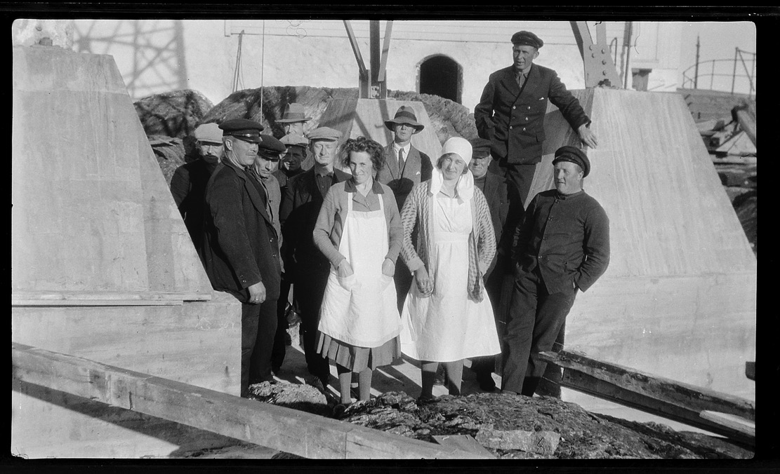
Find out about old naming traditions
What was your name again?

Slide 8
Peder Johnsen Berg

Slide 9
Peder Johnsen Berg

Slide 10
Peter Johnsen Berg

Slide 11
Petter Johnsen Berg

Slide 12
Per Johnsen Berg

Slide 13
Peder Johnsen Berg

Slide 14
Peder Johnsen Berg

Slide 15
Peder Johnson Berg

Slide 16
Peder Johnsen Berg

Slide 17
Peder Johnsen Vik

Slide 18
Do your homework on the Digital Archives

Slide 19
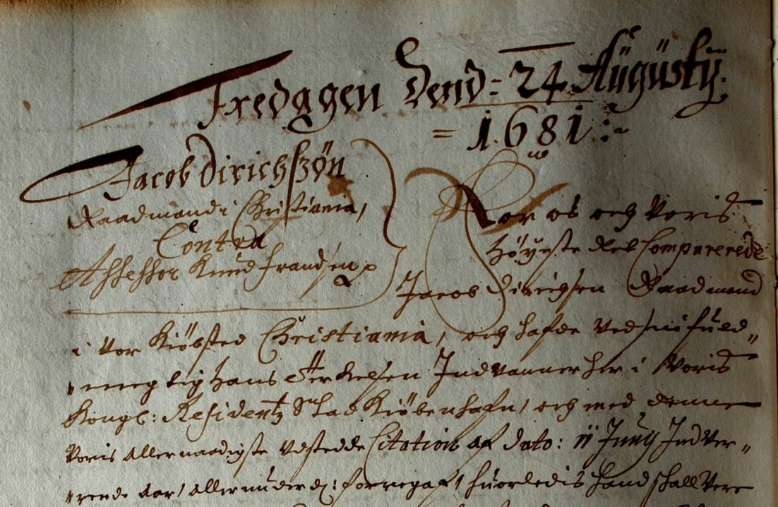
Be prepared to face old handwriting

Slide 20
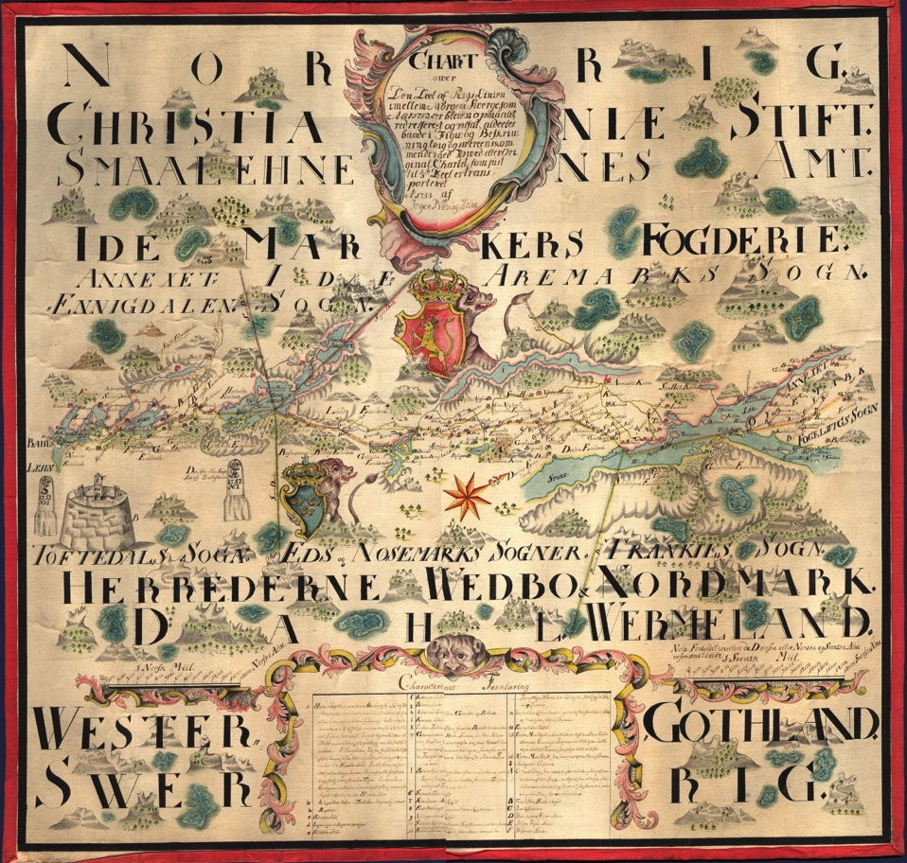
Check out the map

Slide 21
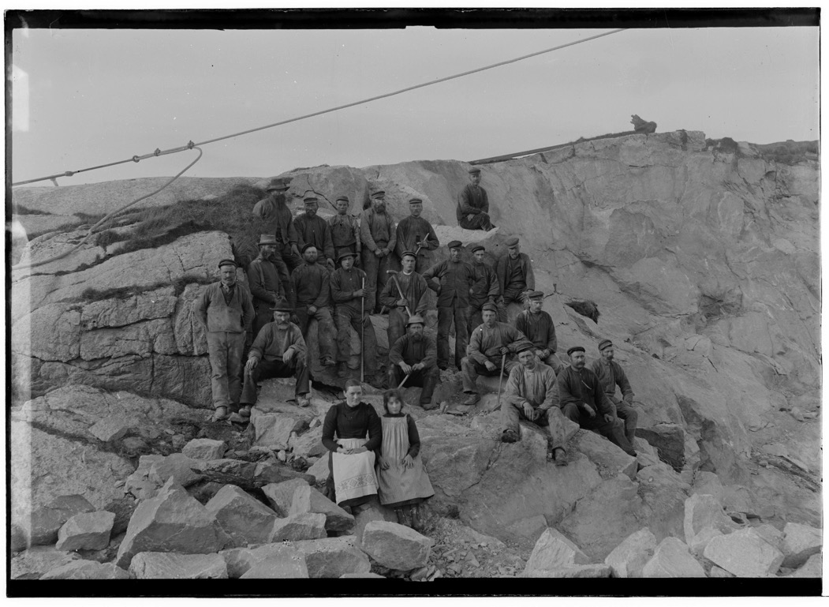
Dig up some local history

Slide 22
Make contacts

Slide 23
When in Norway

Slide 24
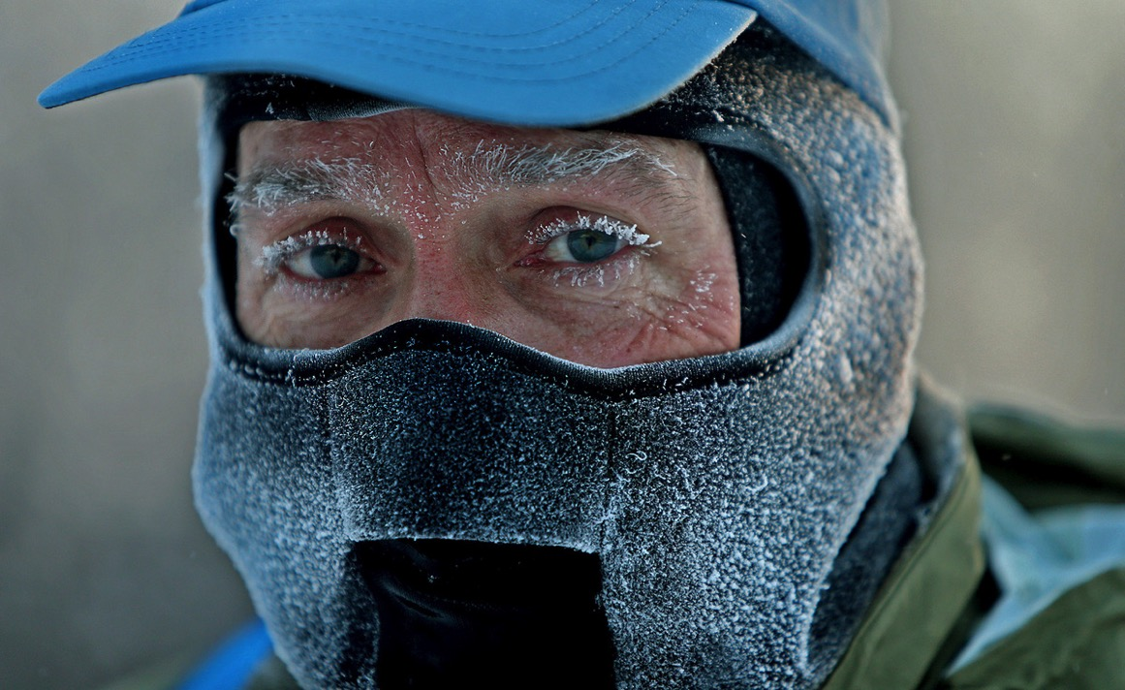
Bring warm clothing

Slide 25
Buy a prepaid Norwegian SIM card

Slide 26
Just a name won’t get you far
H
Hi, I’m looking
for Ole Olsen!

Slide 27
Bring a camera

Slide 28
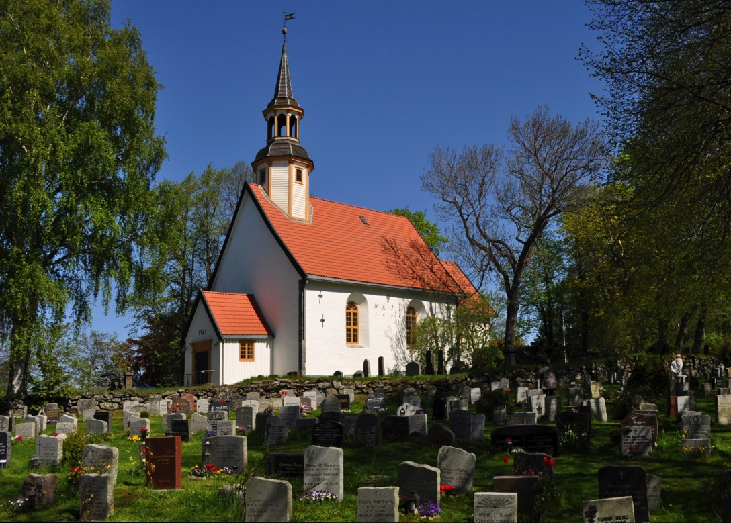
Visit cemeteries

Slide 29
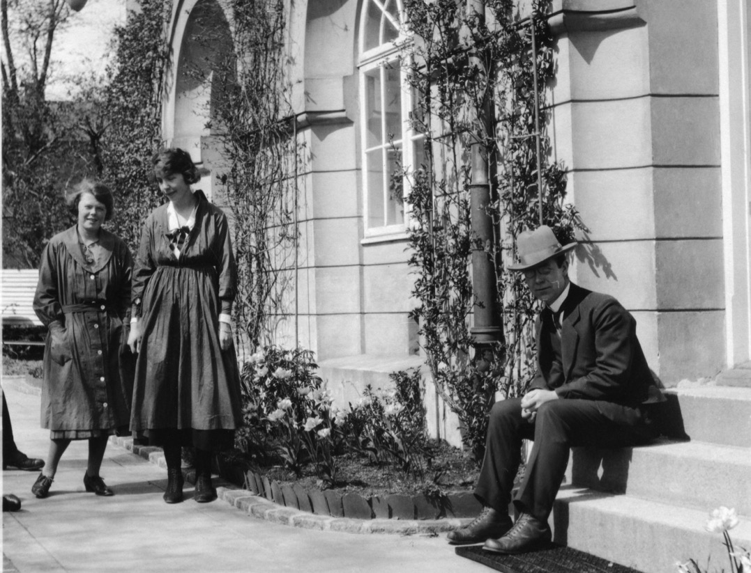
Make more contacts
I
I think those two lovely ladies might be my cousins.

Slide 30
Things take time

Slide 31
Prepare

Slide 32
Prepare
Prepare

Slide 33
Prepare
Prepare
Prepare

Slide 34
Good luck!
And welcome to Norway!

