Slide 1
The Norwegian Archival System: Relevant Services and Sources for Norwegian-American Family History
Fredrik Larsen Lund, adviser
National Archives of Norway (Riksarkivet)

Slide 2
Who are we?

Slide 3
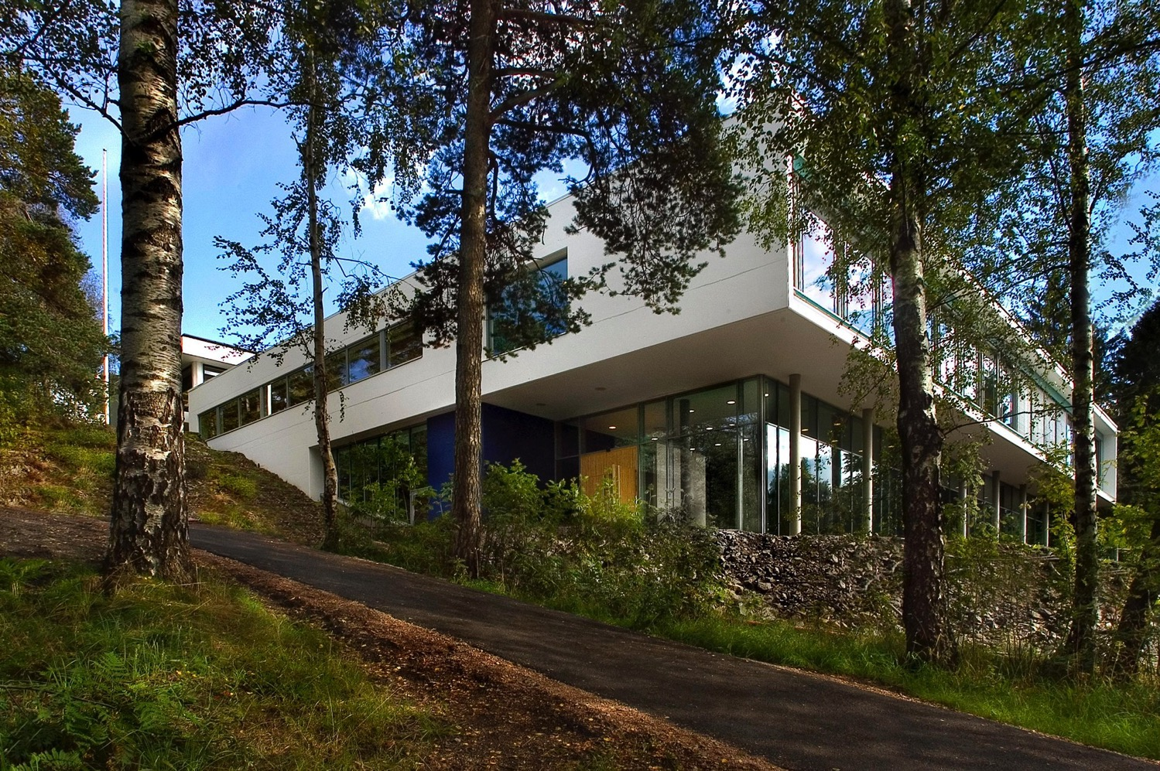

Slide 4
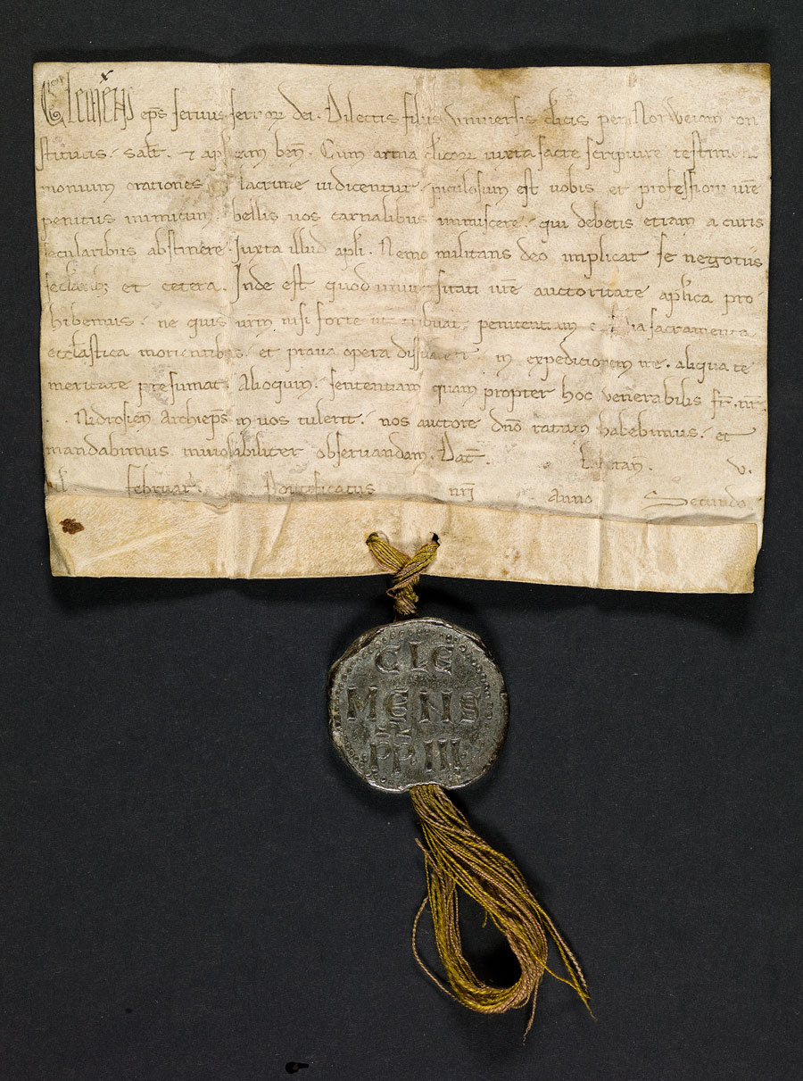

Slide 5
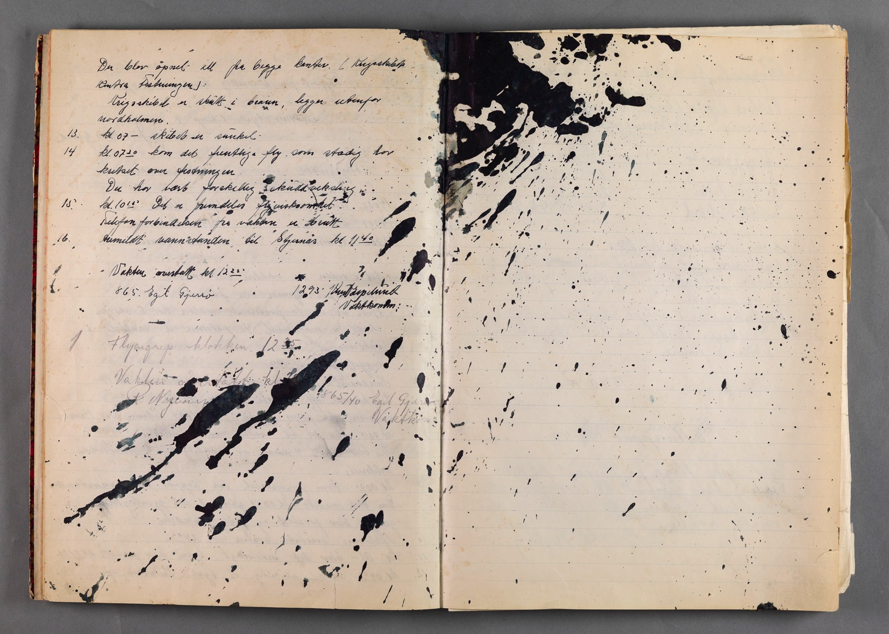

Slide 6
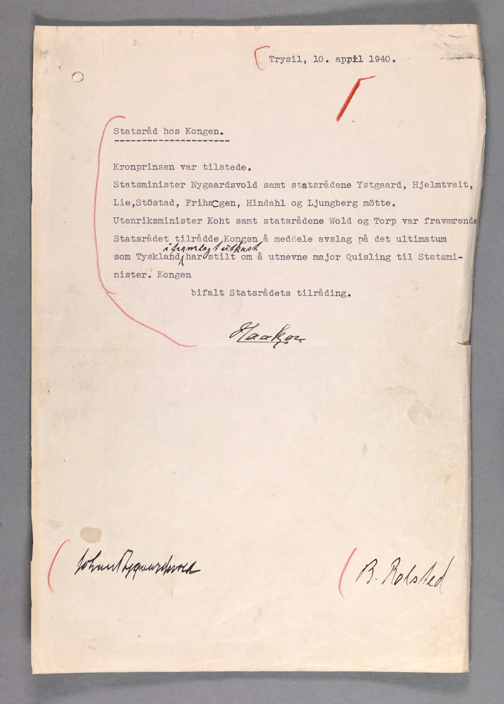

Slide 7
What do we do?

Slide 8
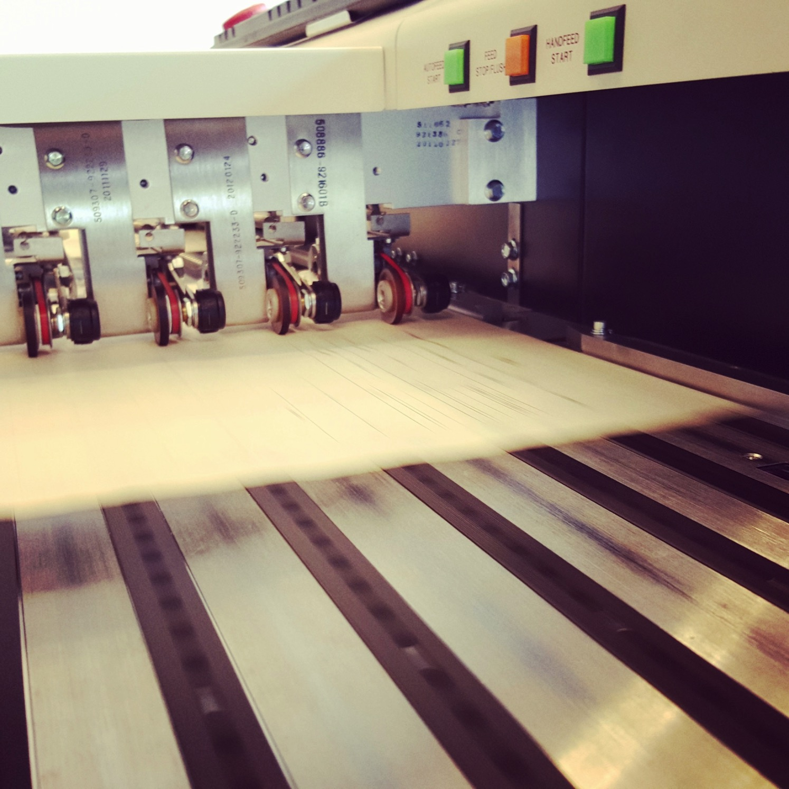
Main responsibilities of the National Archives of Norway
Keep records from all government agencies.
Ensure that the material is available for use.
Oversee state, county and municipal record keeping.
Contribute to the preservation of private archives.

Slide 9
 | Archives | Libraries
Unpublished case files (letters, protocols, other documents) from public or private entities. | √ | x
Published material (books, periodicals, newspapers, brochures etc.). | x | √
But sometimes libraries keep archival material ... and archives might have their own libraries ...

Slide 10
Where are we?

Slide 11
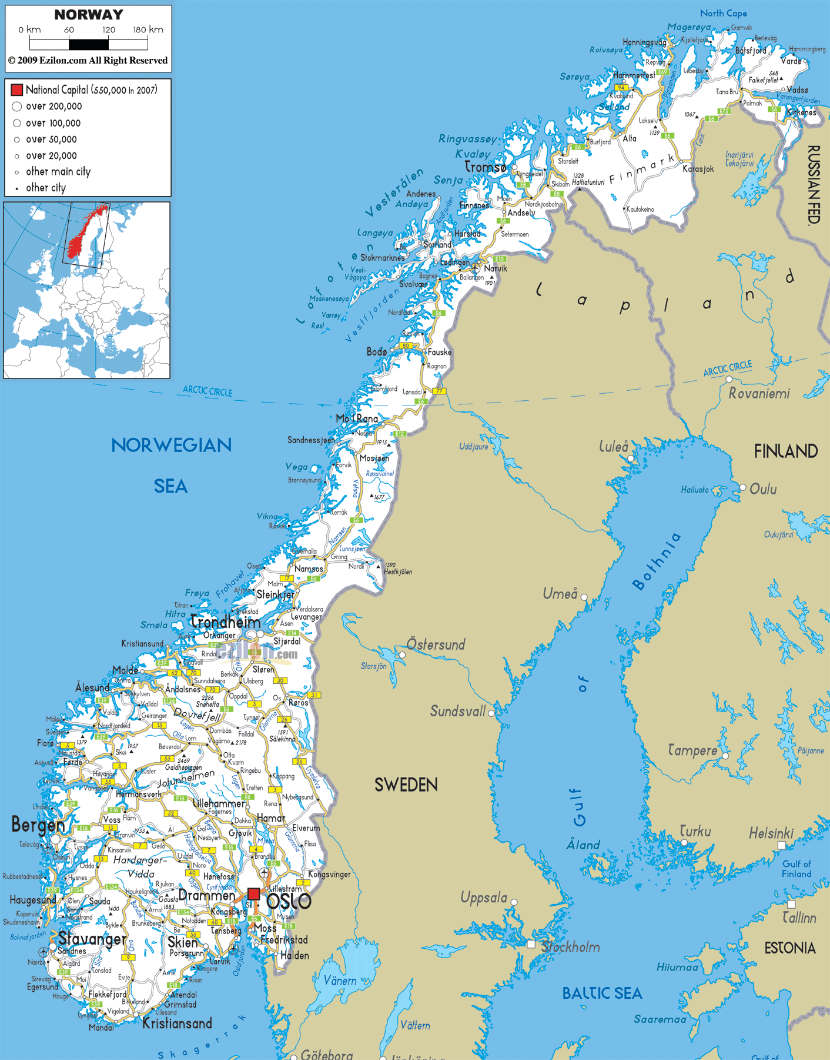
•
•
•
•
•
•
•
•
•

Slide 12
 | Riksarkivet (Oslo) | Statsarkiv (Regional State Archives)
Archives from cabinet ministries, supreme court, central government agencies and other national state institutions. | √ | x
Archives from regional and local (branches of) state agencies. | x | √
Archives from private organisations, businesses, individuals. | √ | √

Slide 13
What do we have?

Slide 14
What kind of material
can you access?

Slide 15
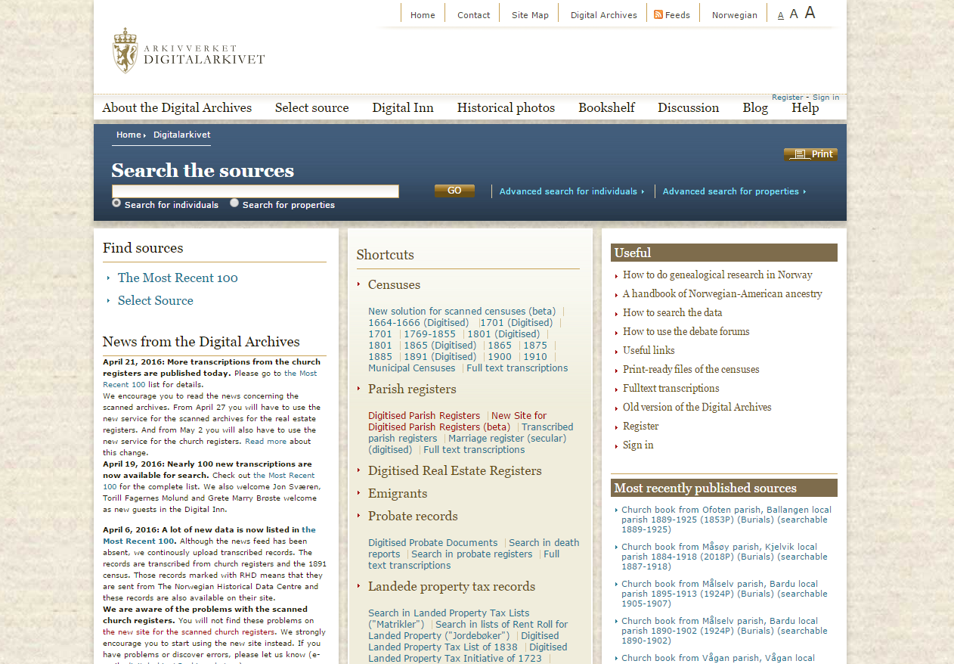
www.arkivverket.no/digitalarkivet

Slide 16
What can you find in the Digital Archives?
Censuses (1664-1910).
Parish registers (1600s-1900s).
Real estate registers.
Probate records (until 1950).
Emigrant lists (1800s-1900s).
Landed property tax records (1500s-1800s).
Accounts and tax lists (1500s-1800s).
Legal proceedings and sanctions.
Address books for Kristiania/Oslo and Aker.
… and more!

Slide 17
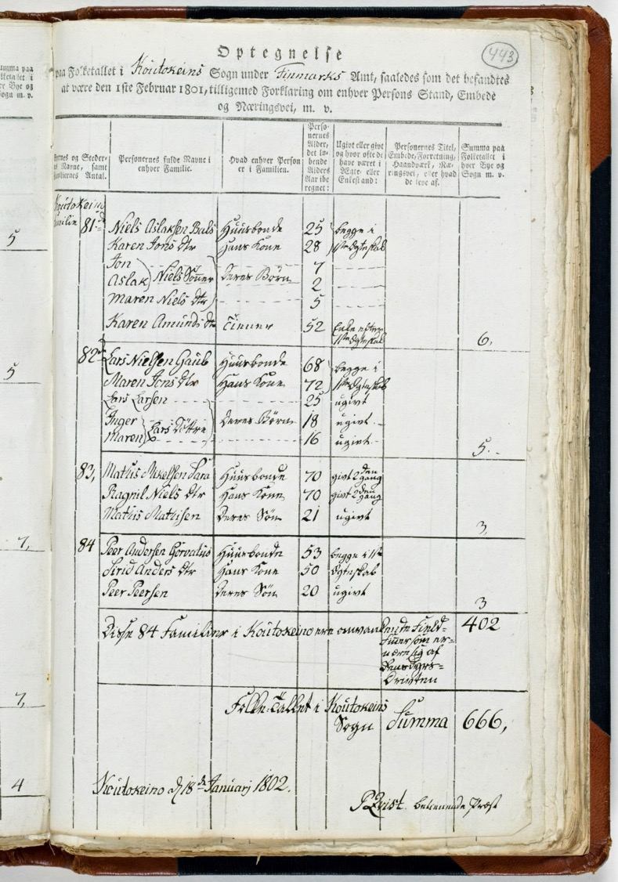
Censuses

Slide 18
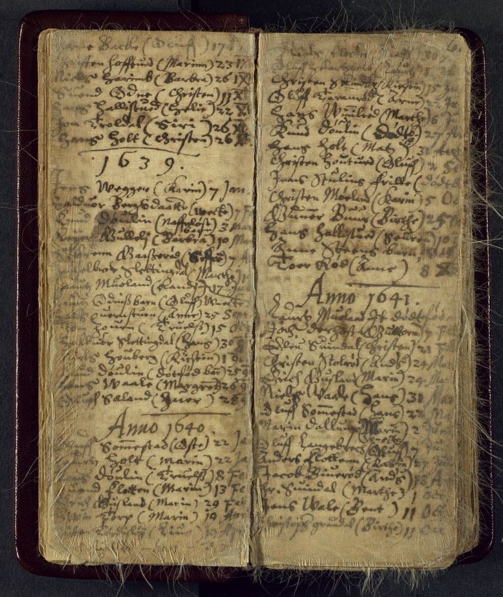
Parish records

Slide 19
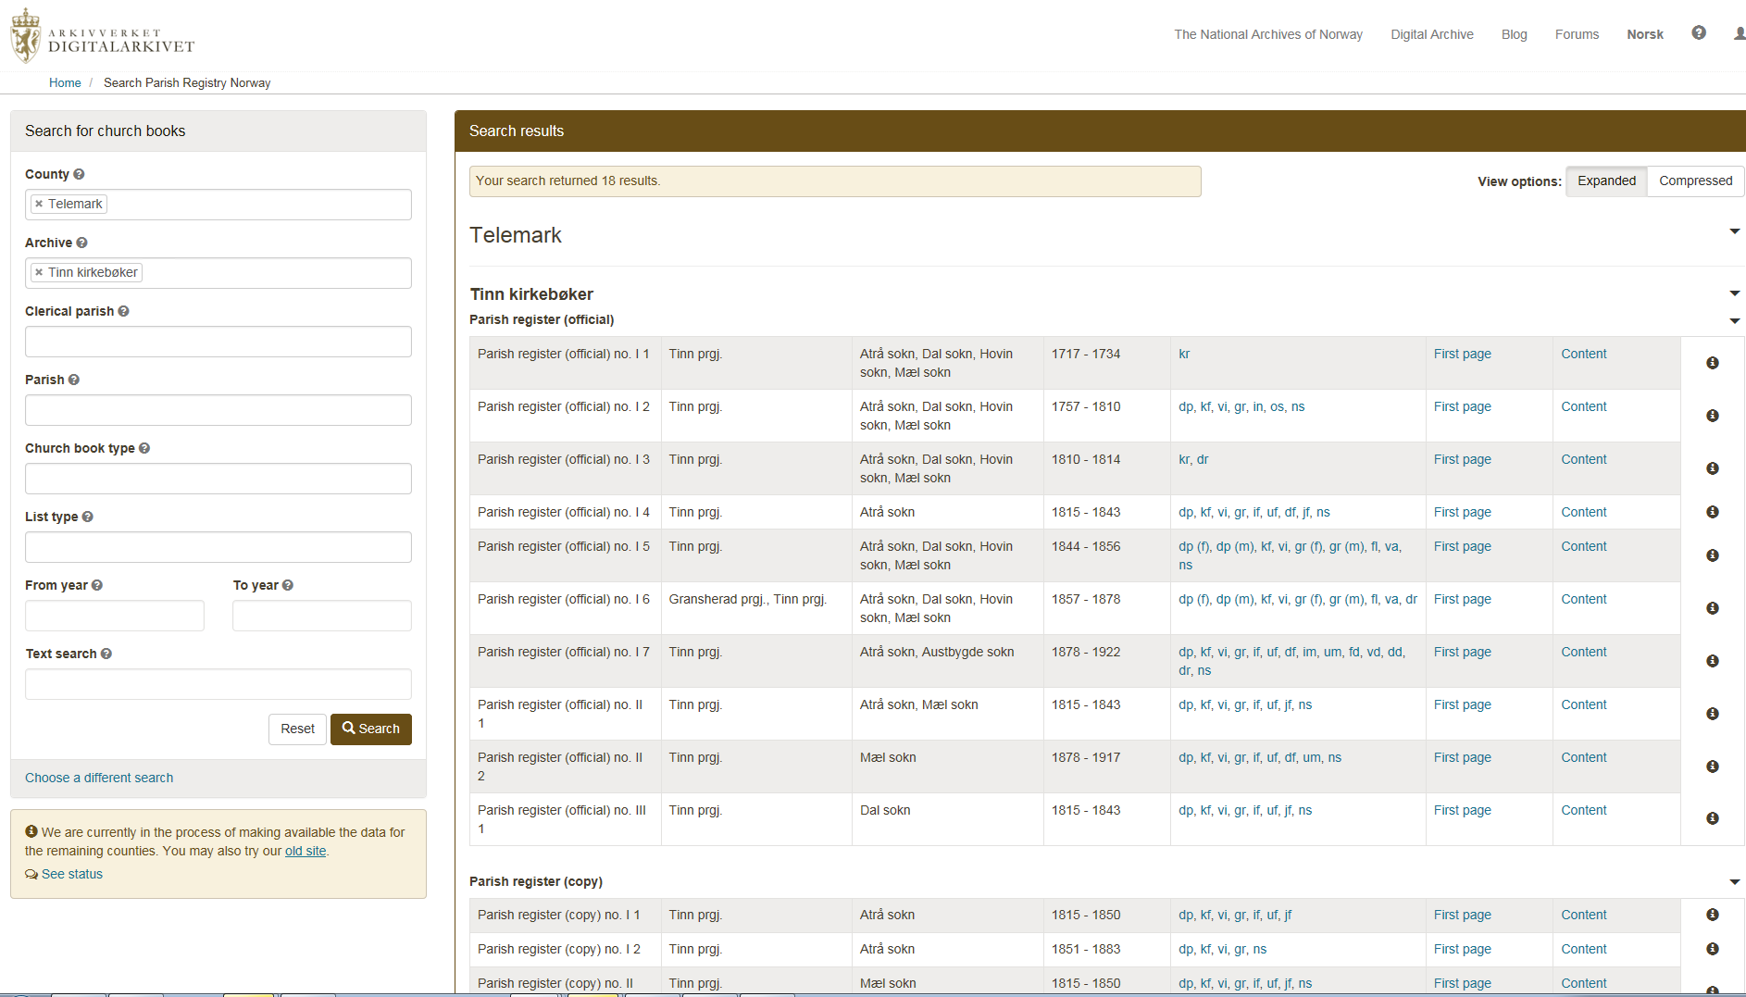

Slide 20
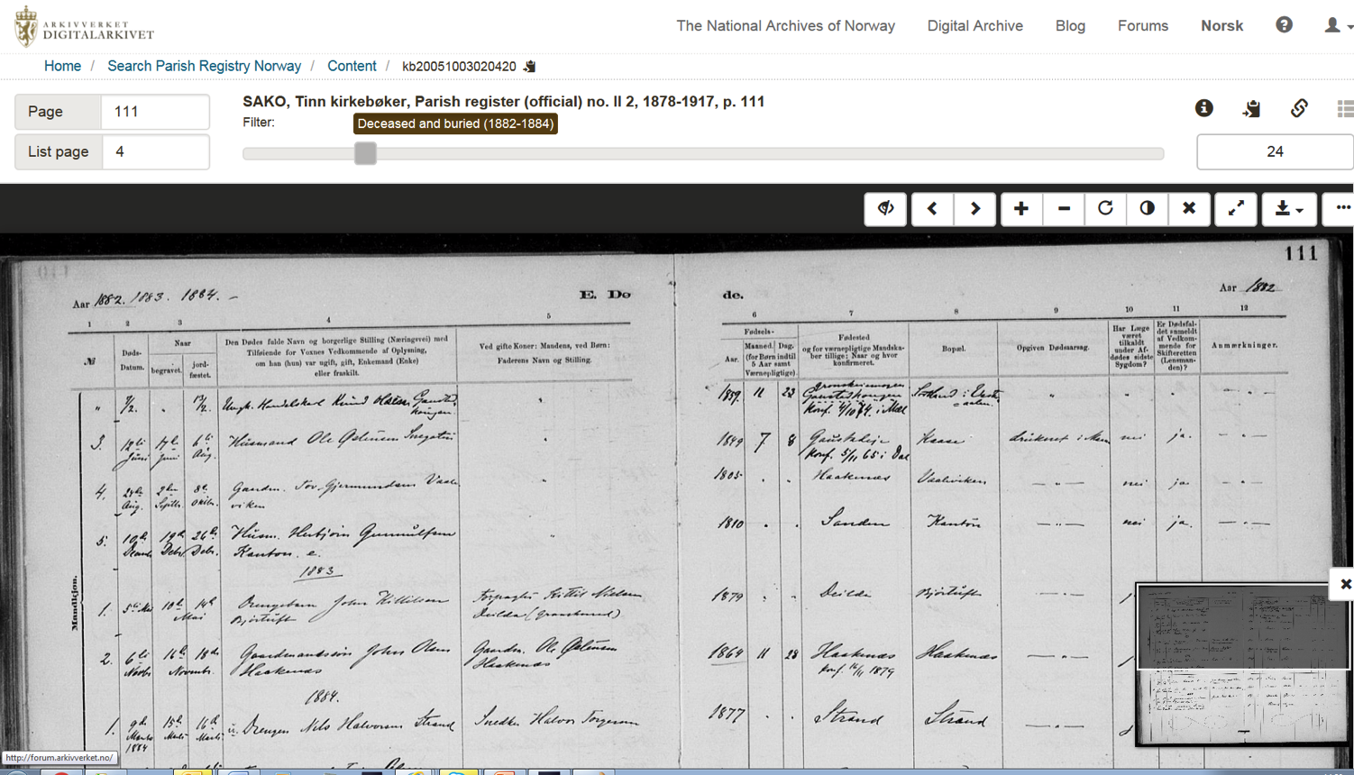

Slide 21
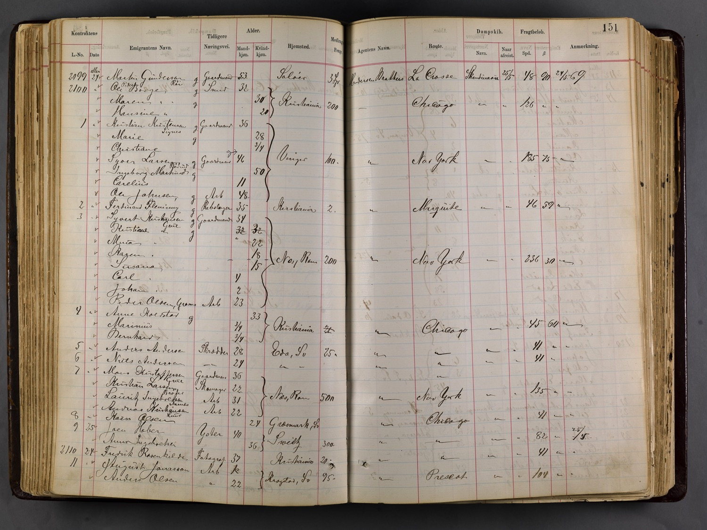
Emigrants

Slide 22
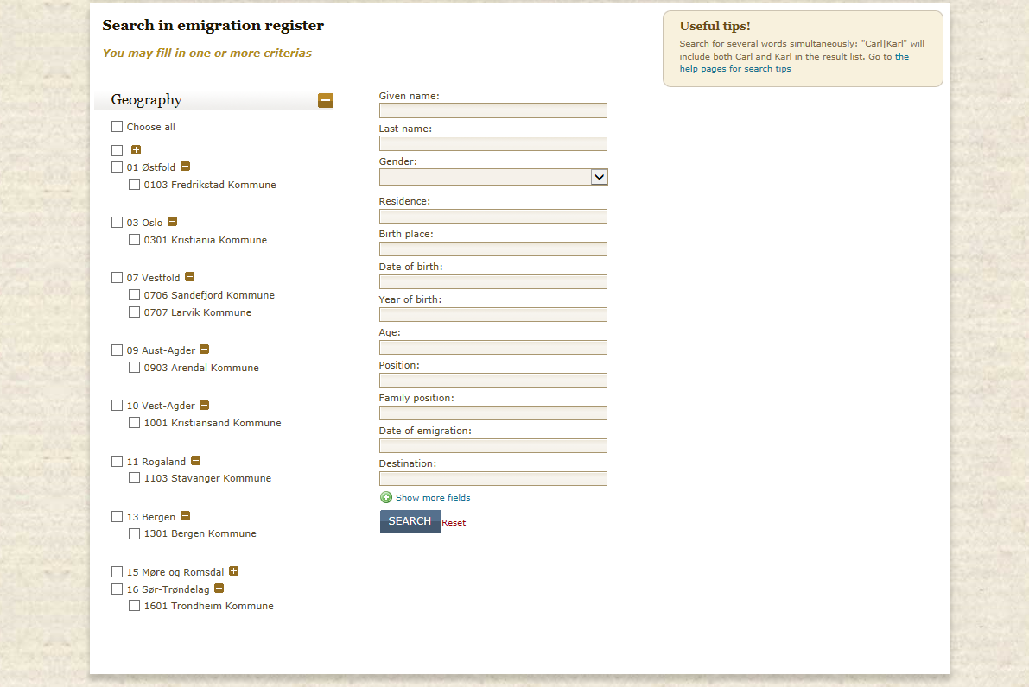

Slide 23
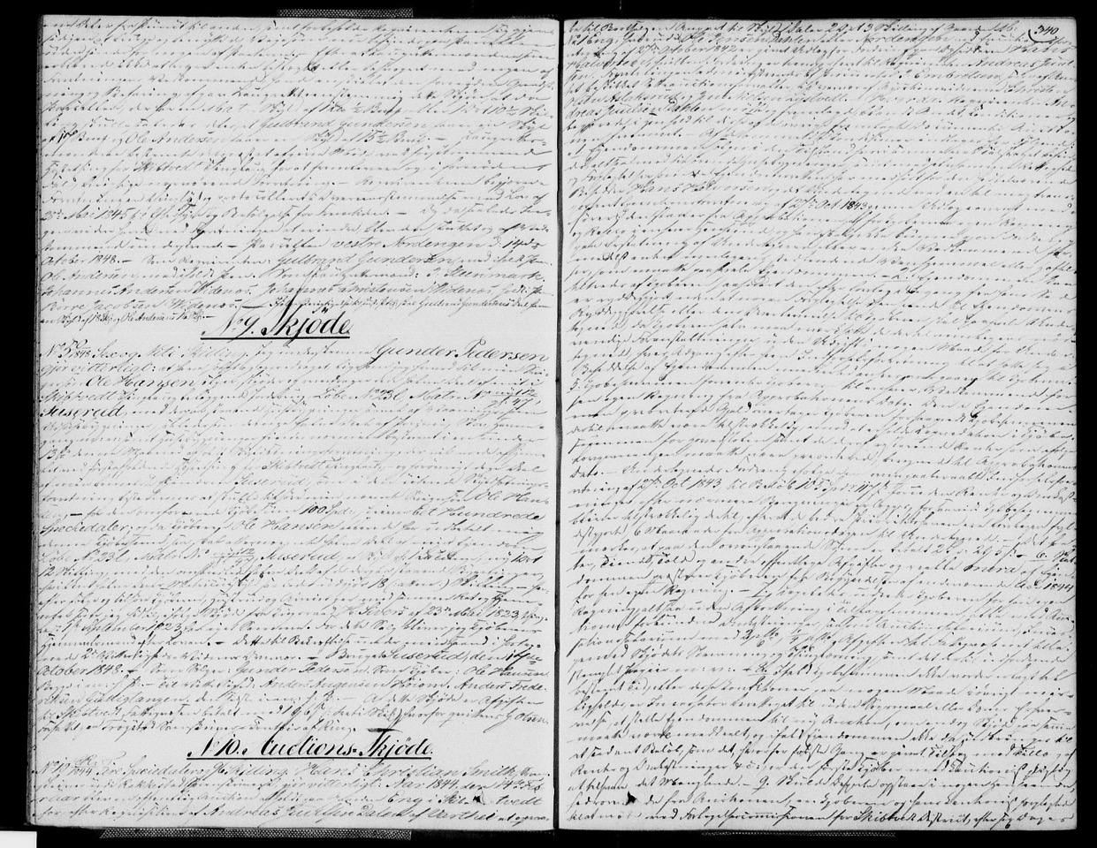
Land title

Slide 24
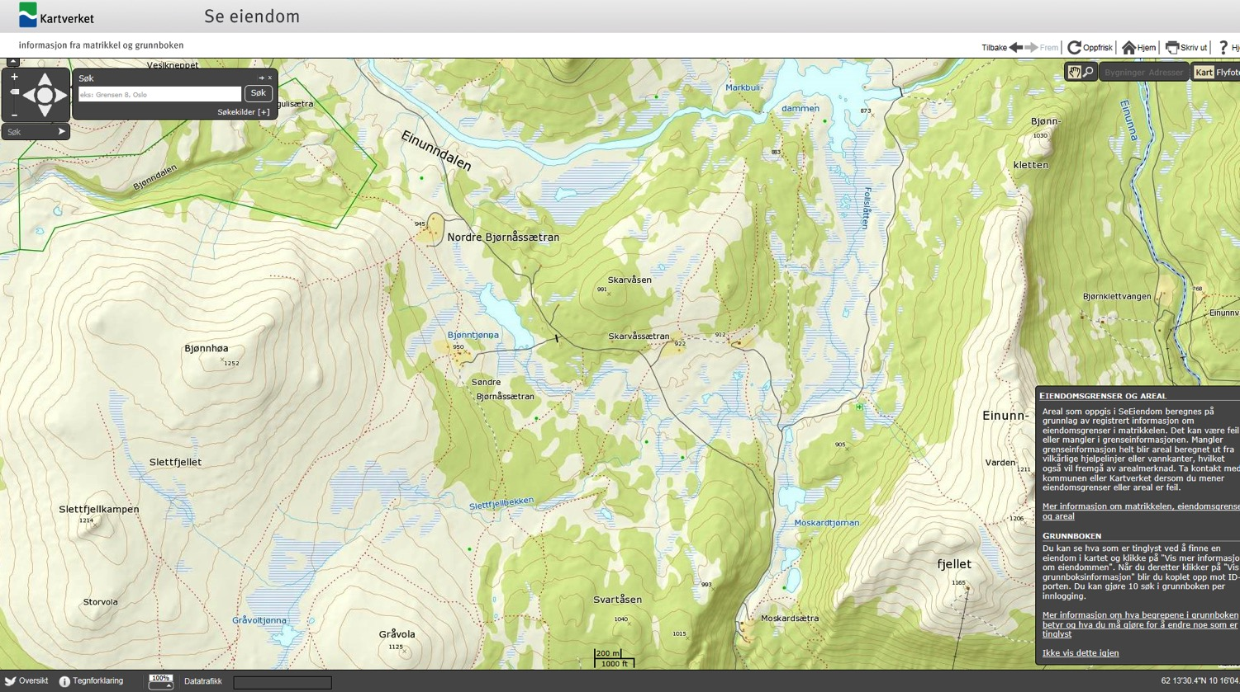
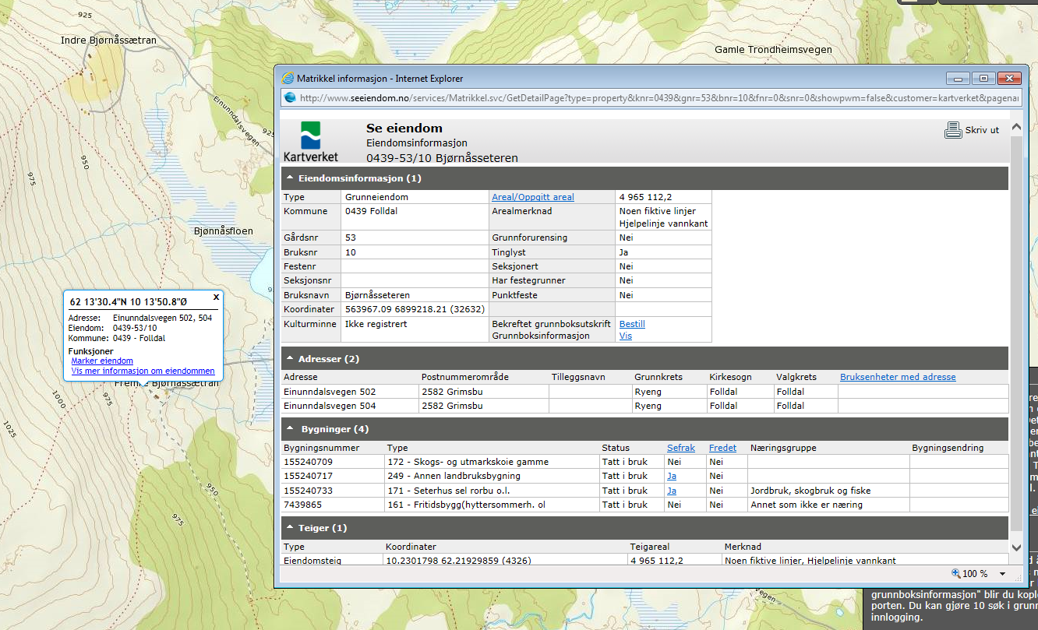
www.seeiendom.no

Slide 25
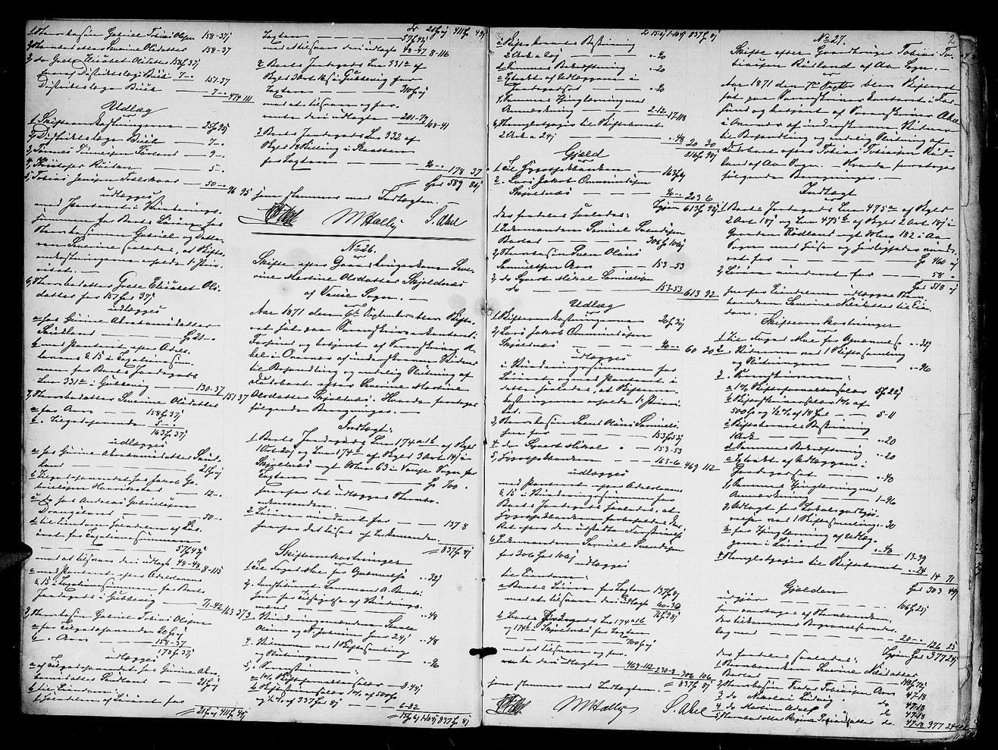
Probate records

Slide 26
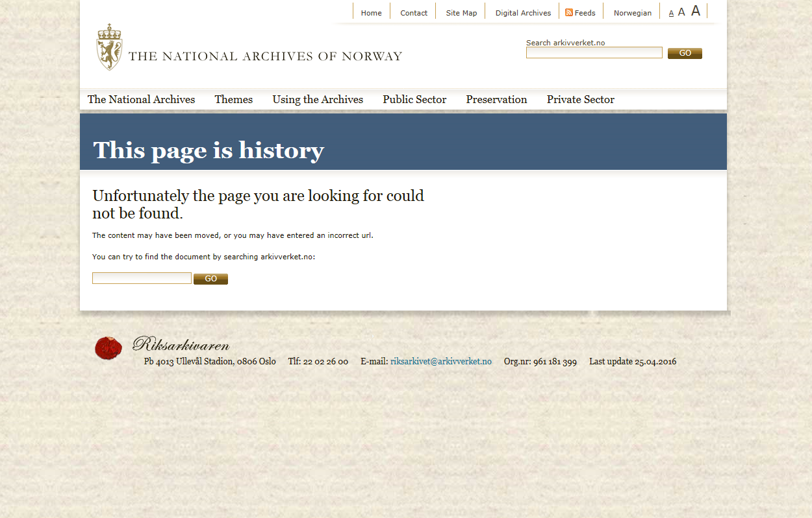

Slide 27
What else?

Slide 28
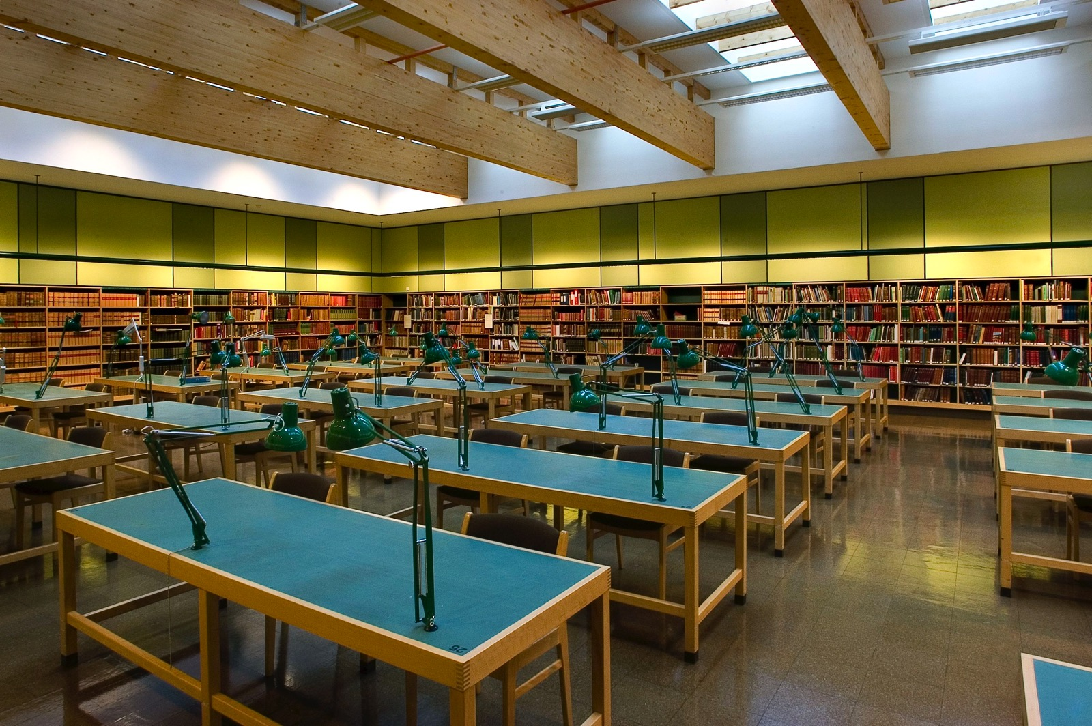

Slide 29
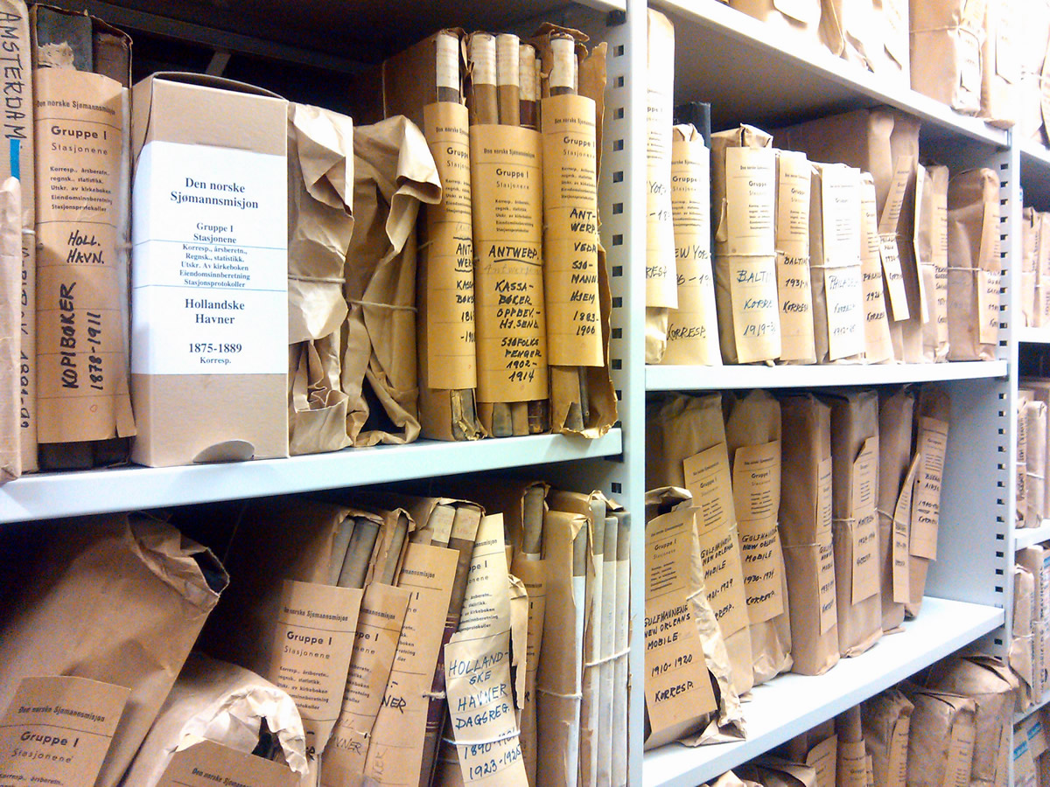

Slide 30
Some of our sources (beyond the Digital Archives)
Passport registers (mostly before 1860).
Registers of residents (folkeregister – from 1900s).
Seamen rolls.
Military rolls.
Divorce and change of name.
Naturalisations (index on Digital Archives).
Fire insurance valuation.
Embassies and consulates.
Prisons and penal institutions.
Treason (World War II).
Private archives; individuals, businesses, organisations.
Maps, photographs, genealogical collections.
… and much more!

Slide 31
Restrictions on use
Sensitive information about individuals may be restricted under Norwegian law.
Private and personal matters are subject to confidentiality, e.g. health issues, political opinions, personal finances, criminal records, family law issues etc.
General rule: 60 years after the infomation was created.
In some cases extended to 80 or 100 years.

Slide 32
www.arkivverket.no/eng
National Archives’ main website: General information and guides in English. Contact details.
www.arkivportalen.no
National search site for archival catalogues (content lists). You can request material in advance. In Norwegian only.
www.arkivverket.no/digitalarkivet
Digitised source material.

Slide 33
There are many other tools to help you
Literature about your topic of interest – particularly bygdebøker (village books) and local/family history.
The online forums on the Digital Archives.
Analogue catalogues/guides to archives – in reading rooms.
Ask a member of staff when you visit us.
Send us an enquiry – contact info at www.arkivverket.no.

Slide 34
Future plans

Slide 35
Re-organisation of the National Archives.
New website in 2017 – more use-friendly & more self-service.
Some paid services may be introduced – i.e. genealogical research and digitalisation on demand.
Focus on digitialisation – more material online on the Digital Archives.
1 Dec 2020: The census of 1920 will be released to the public.
Digital Archives 3.0.

Slide 36
Other institutions

Slide 37
Municipal & city archives
Private archival institutions
University libraries & archives
National & municipal libraries

Slide 38
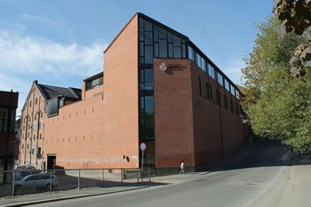
Oslo city archives (Oslo byarkiv)
Municipal censuses (Oslo area).
Address books.
Tax lists.
Planning department/buildings.
Pauper administration (fattigvesen).
Local schools.
Various other sources relating to indviduals.
Reading rooms are located in Maridalsveien no. 3 in Oslo, near the city centre.
More information:
https://www.oslo.kommune.no/natur-kultur-og-fritid/byarkivet/
E-mail: postmottak@kul.oslo.kommune.no

Slide 39
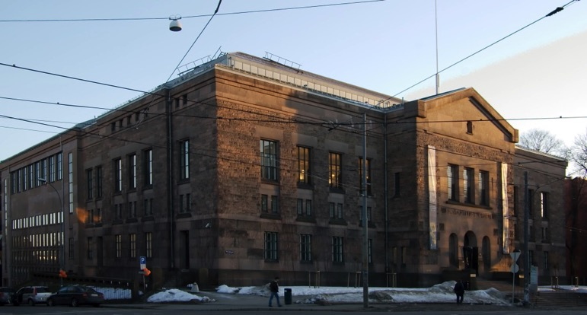
National Library (Nasjonalbiblioteket)
«Everything» published in Norway. Physical books are kept in vaults; must be ordered in advance.
Extensive Norwegian-American collection.
Bokhylla: Digitised content. More than 230 000 books + newspapers and more. Some restrictions due to copyright.
Widerøe aerial photo archive; shows many farms etc.
Complete collection of bygdebøker (village books) on site. No need to order.
Collection of newspaper clippings on individuals.
Private archives; mainly cultural figures.
The National Library offers guidance and advice for visitors.
Location: Solli Square, Henrik Ibsens Street no. 110, Oslo.
For specific questions, best to contact them in advance:
www.nb.no
E-mail: veiledningen@nb.no

Slide 40
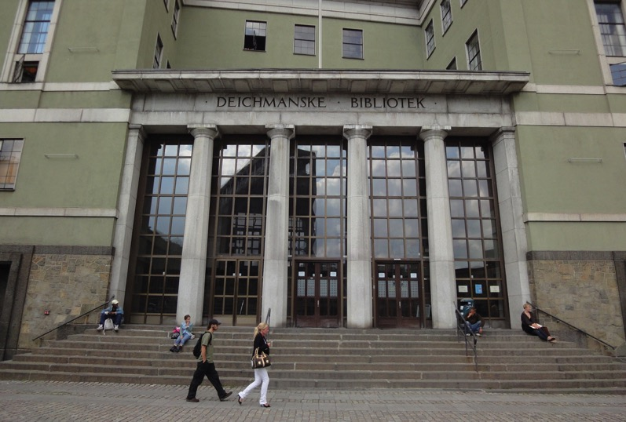
Deichmanske Library
Has many genealogy resources.
Family and local history (bygdebøker etc.) located in ”blue zone”, level 2.
Large collection of Oslo books.
General reference; encyclopaedias, address books etc.
Many books are held in vaults; ask at their enquiry desk and they will fetch them. No need no book in advance.
Newspapers, periodicals etc. Some sources on microfilm.
Please prepare for your visit and be as specific as possible when requesting information.
Located in the city centre at Arne Garborg’s Square no. 4.
www.deichman.no
Norwegian-Americans welcome!

Slide 41
Some final thoughts

Slide 42
Everyone is welcome to visit Norwegian archives and libraries.
Requesting and using material is free.
Most of our material has unrestricted access.
We can offer advice but you have to do the research yourself.
Using archives takes time and patience.
But it is also rewarding and can be a lot of fun!

Slide 43
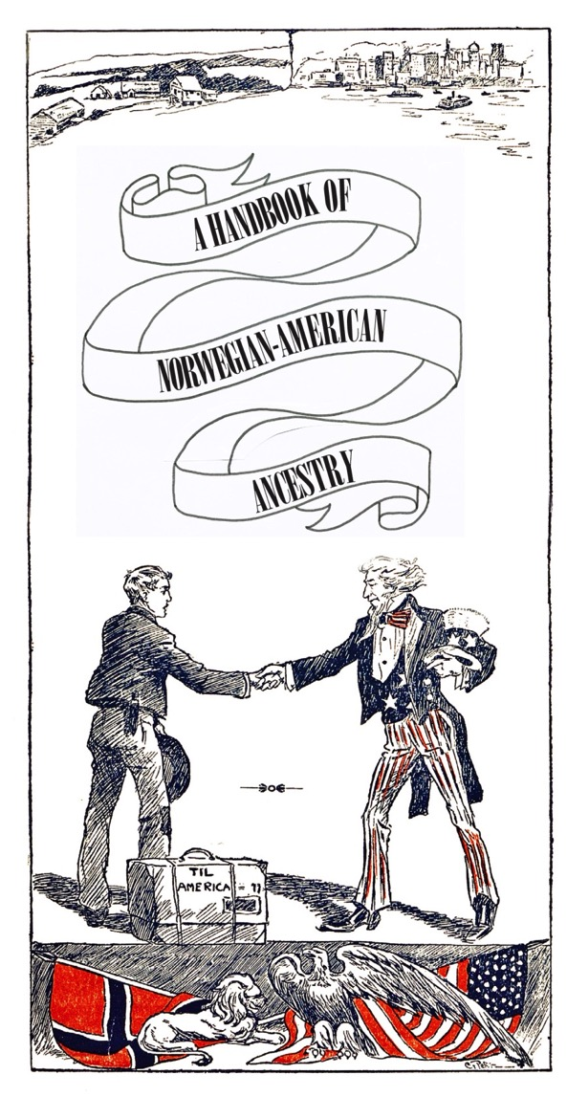
NEW BROCHURE!
Please grab
a free copy today

